Slide 1
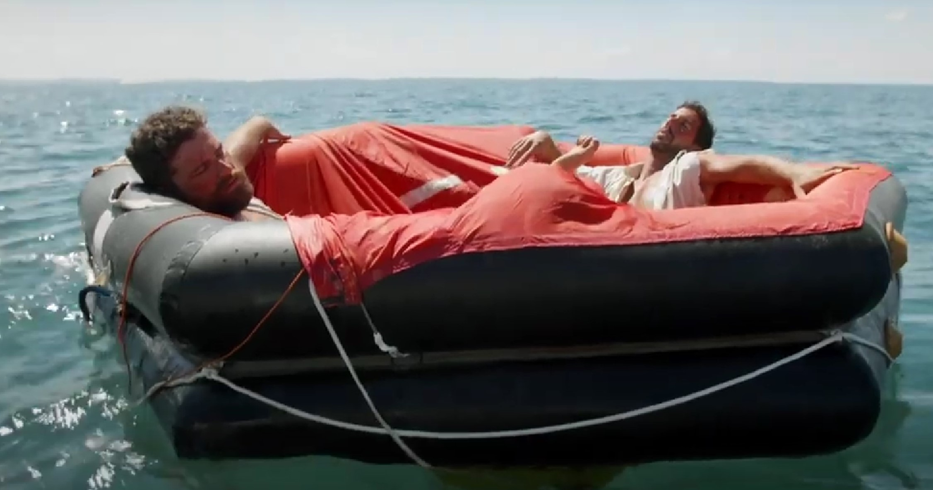
Live is Life

Slide 2
Live isLife
Ever since the day of Adam and his wife, have command & taught them how to labor, care, and live on earth. After thousand and thousands of years had gone by, the population have grown on earth and number of them eventually have forgotten the way have taught them how to labor, care, and live on earth. When they choose to live by their own way instead YAH, they became a divided people, and they became slave to the worldly of man’s rule. These people did not live well in their life, because they disbelief and rebel against ’s way of life. Therefore, many of us today no longer live well in good health even so we might disagree with this facts. Let see why that true.

Slide 3
Live isLife
There was a time Israelites were slave in Egypt for over 400 plus years, until finally redeemed them. than reminded HIS people once again how to labor, care, and live on earth. That day, this time HE fingers wrote on two table stones. This way they won’t forget. Still…. have often delivered them out of slavery many times. Such as the rulers of Assyria, Babylon, Persia, Greece, and Rome kingdom. They still have rebell and forgotten the way taught HIS people about life. They rather live by the dark way even, so they unable to recognize it. Until after they finally recognize it, they cry out loud and ask help to be heal and to get out of trouble etc...
The whole point of this, people today are no longer able to survive on their own popularly. Because they did not fully trust in .

Slide 4
How Would They Survive?

Slide 5
How Would They Survive?
Probably caught one of the sea creature and ate it.
Probably caught a bird and ate it.
Probably had an emergency food kits and ate it.
Probably drank the rainwater.
Probably called upon their God for help.

Slide 6
How Do They Survive?
Probably caught one of the sea creature and ate it.
Question: What kinds of sea creature did they possibility ate?
1. Jellyfish
2. Tuna
3. Dolphin
4. Lobster
5. Octopus
6. Clam

Slide 7
How Do They Survive?
Probably caught a bird and ate it. Question: what flying creature did they possibility ate?
1. Crow
2. Seagull
3. Eagle
4. Vulture
5. Bat

Slide 8
Question: Is it wrong or okay to eat any of these kind of animals in order to continue to survive?

Slide 9
NO! Because
According to Leviticus chapter 11 & Deuteronomy chapter 14, it clearly not okay to eat the unclean animals, because it is forbitten.

Slide 10
For the sake of our life, we must follow and respects the foundation law who created us, know what best for us, know how our body health work, and know what our body need in order to live in good health no matter what.

Slide 11
If we did eat these unclean foods in order to survive, we will still get sicker or died. Just as how warned Adam and his wife not to eat the forbidden fruit.
Genesis 2:17 “…for in the day that thou eatest thereof thou shalt surely die.”

Slide 12
Notice:
After Adam and his wife did eat the forbidden fruit, but why didn’t they not die on the same day?

Slide 13
It is because like a thousand years on earth would be like a day in heaven (Psalm 904).

Slide 14
Not one had ever live 1,000 years
Adam live at 930
Seth live at 912
Enosh live at 905
Kenan live at 910
Mahalalel live at 895
Jared live at 962
Methuselah live at 969
Lemech live at 777
Noah live at 950

Slide 15
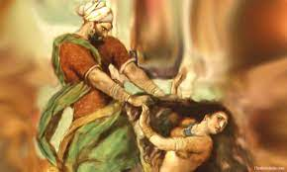
Attacking Life

Slide 16
Attacking Life
Question:
How do we to judge on behalf those who have attack life?

Slide 17
Attacking Life
Situation like:
1. Physical Attack/Abuse to Harm or Damage
2. Physical Attack/Abuse to Death
3. Physical Attack/Abuse to Rape
4. Physical Attack/Abuse to Abortion the Unborn Child

Slide 18
What Does The Torah or Wisdom Say About The Question?
Physical Attack/Abuse to Harm or Damage a Person
— “…if any harm follows, then you are to penalize life for life, eye for an eye, tooth for a tooth, hand for hand, foot for foot, burn for burn, wound for wound, blow for blow.” - Exodus 21:23-25
— “If people quarrel, and one strikes the other with a stone or with his fist, and the other does not die but lies in bed, if he rises again and walks around on his staff, then the one that struck him he will be cleared. But he must pay for the loss of his time and help him to be thoroughly healed.” - Exodus 21:18-19
— “If men fight and hit a pregnant woman so that her child is born early, yet no harm follows, the one who hit her is to be strictly fined, according to what the woman’s husband demands of him. He must pay as the judges determine. - Exodus 21:22

Slide 19
What Does The Torah or Wisdom Say About The Question?
Physical Attack/Abuse to Death
— “Whoever strikes a man so that he dies must surely be put to death." - Exodus 21:12, Leviticus 24:17, Genesis 9:6, Deuteronomy 17:6, & Numbers 35:29-31
— “If a thief is found breaking in and is struck so that he dies, there shall be no bloodguilt for him, but if the sun has risen on him, there shall be bloodguilt for him.” - Exodus 22:2-3
— “…when someone goes into the forest with his neighbor to chop wood, and his hand takes a swing with the axe to cut down the tree, and the iron flies off the wood and hits his neighbor so that he dies. He may flee to one of these cities and live…’ -Deuteronomy 19:4-7

Slide 20
The law in Torah simply explain, who ever take away someone life (murder someone), will lost their life also.
Therefore, we must not think we can get away from murder, can still bring punishment death to those who have taken away someone’s life.

Slide 21
also teaches HIS people about being save by anyone who wish to murder one of HIS people, HE does not want us to fear death. Because HE will protect HIS people and HE can even resurrection those who died. is always with those who dwells in the shelter of the Most-High will abide in the shadow of the Almighty ONE, . HE will protect those who with HIM, HE will give us strengthen. HE wants us to fully trust in HIM.
Isaiah 35:4 said - Say to those who have an anxious heart, “Be strong; fear not! Behold, your will come with vengeance, with the recompense of Almighty ONE . He will come and save you.”

Slide 22
Therefore, we must not think we can get away from harm or murder, will still bring punishment to those who have cause the harm or taken away someone’s life.

Slide 23
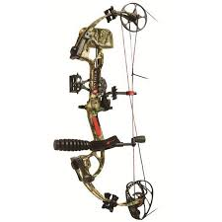
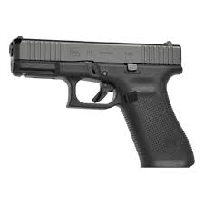
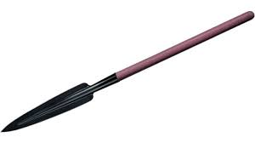
This is the reason why ancient Israelites inside the Jerusalem before the gate do not have any powerful weapons. Such as spear or bow to use against one another, their own neighbor. Only the soldiers who are also called the watchmen, guards outside the gate and/or the top of the tower look out for unknow enemy have these powerful weapons. The reason is the enemy are not their neighbor (non-Israelites people) who are foreigner who might try to invade their land.

Slide 24
Are All Scientists & Doctors on Earth a Healer?

Slide 25
Are All Scientists & Doctors on Earth Good?
Does the scientists and doctors serve and
respect the LAW of LIFE?
1. Doctor who is a medical surgeon?
2. Scientist who is a biomedical?
3. Scientist who is a biologist?
4. Doctor who is an Anatomy?
5. Scientist/Doctor who is a medical engineer?

Slide 26
Answer is BIG NO, WHY is that?
It is because is the ONLY healer. Those who love to care for someone and want to help and heal that person have no idea why they shouldn’t do such performing work of healing people by open surgery, doing a laboratory dangerous work, or doing any of anatomy study for the future welfare people health etc… It is like the old saying, do not playing God.
It is against the law for performing these kinds of healing work. Most of scientists and doctors today no longer being instructed in school popularly without the scripture books. There are numerous of reasons why is against their doing.
Tell me where in the scripture books of Torah teach such doctorate except for the circumcision and castration surgical in Genesis 17:10-11?

Slide 27
Everyone Have Forgotten This Simple Rules:
Exodus 15:26 - “If you will diligently listen to the voice of your Almighty ONE, and do that which is right in HIS eyes, and give ear to his commandments and keep all his statutes, I will put none of the diseases on you that I put on the Egyptians, for I am the Almighty ONE, your healer.”
Deuteronomy 32:39 - “See now that I, even I, am he, and there is no Almighty ONE beside me; I kill, and I make alive; I wound, and I heal; and there is none that can deliver out of my hand.

Slide 28
Is This Still Concerning Attacking the Way of Life?
YES!
It is because
is the ONLY healer. Doctors are not the true healer.

Slide 29
Since is our HEALER (the only DOCTOR) according to Exodus 15:26, we must realize why the body must not remain on the ground or in the air “all night” according to Deuteronomy 21:23. Meaning when a person die whether during the daylight or night, that person who die must be bury on the very same day, because after night is another day.
This is the MOST reason why we MUST NOT do such open surgery on people’s body for science research and studies.

Slide 30
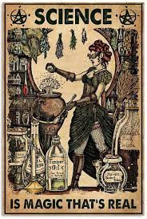
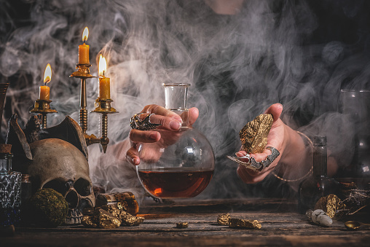
There is one more reason. Many of us do not realize most of these scientific or doctorate perform works came from witchcraft & magic works.

Slide 31
When you enter the land the Almighty ONE, is giving you, do not learn to imitate the detestable ways of the nations there. Let no one be found among you who sacrifices their son or daughter in the fire, who practices divination or sorcery, interprets omens, engages in witchcraft, or casts spells, or who is a medium or spiritist or who consults the dead. Anyone who does these things is detestable to ; because of these same detestable practices the Almighty ONE, will drive out those nations before you. You must be blameless before . - Deuteronomy 18:9-13

Slide 32
Therefore, this is what the Sovereign ONE says: I AM against your magic charms with which you ensnare people like birds, and I will tear them from your arms; I will set free the people that you ensnare like birds. - Ezekiel 13:20

Slide 33
We are to call upon YAH for healing situation:
Once again, remember what Exodus 15:26 said: He said, “If you listen carefully to , your Almighty ONE and do what is right in his eyes, if you pay attention to his commands and keep all his decrees, HE will not bring on you any of the diseases (like) HE brought on the Egyptians, for I AM (YAH) your Creator ONE, who heals you.”
“You are to serve , and He will bless your food and your water. Moreover, HE will take sickness away from your midst.” - Exodus 23:25
“Heal me, , and I will be healed. Save me, and I will be saved. For You are my praise.” - Jeremiah 17:14
“For I will restore health to you and will heal you of your wounds.” It is a declaration of . “For they called you an outcast: ‘Zion—no one cares about her." - Jeremiah 30:17
“He sent His word and healed them and rescued them from their pits. Let them praise for His mercy, and His wonders for the children of men.” - Psalms 107:20-21

Slide 34
Just as why NO ONE can heal the death to rise alive again.
Because is the Master of LIFE

